Slide 1

Online Complaint Registration and Management System
Seamlessly handle customer complaints and streamline resolutions with our intuitive, cloud-based platform.
by
Aamrapali V (9B407084D89A674B64D443D74464DED1 )
Aarchana L Nichani (D74C9E31B067DA2A3E44AD785B32CBC2 )
AARTHI P (68F4B66E36C254EBC41434FADCEBB70C )
ABINAYA R (605AA8EB514BA848F4F4A102EC39C5B8 )

Slide 2
Introducing the Complaint Management System
Efficiently manage customer complaints across three user roles: Users, Admins, and Agents.
User
Admin
Agent
Raises complaints, tracks status.
Manages users, assigns complaints.
Resolves assigned complaints.
VISIT OUR WEB APPLICATION NOW : CLICK HERE

Slide 3

Streamlining Complaint Resolution
Our system aims to improve efficiency and provide quick resolutions for customer complaints.
1
Raise Complaint
Users submit issues with detailed descriptions.
2
Assign to Agent
Admins review and delegate complaints to agents.
3
Resolve Complaint
Agents investigate and provide solutions.

Slide 4

User Features
Empowering users to easily submit and track their complaints.
1
Raise Complaints
2
Complaint Tracking
Users can file issues with detailed descriptions.
Users can view the status of their complaints.

Slide 5
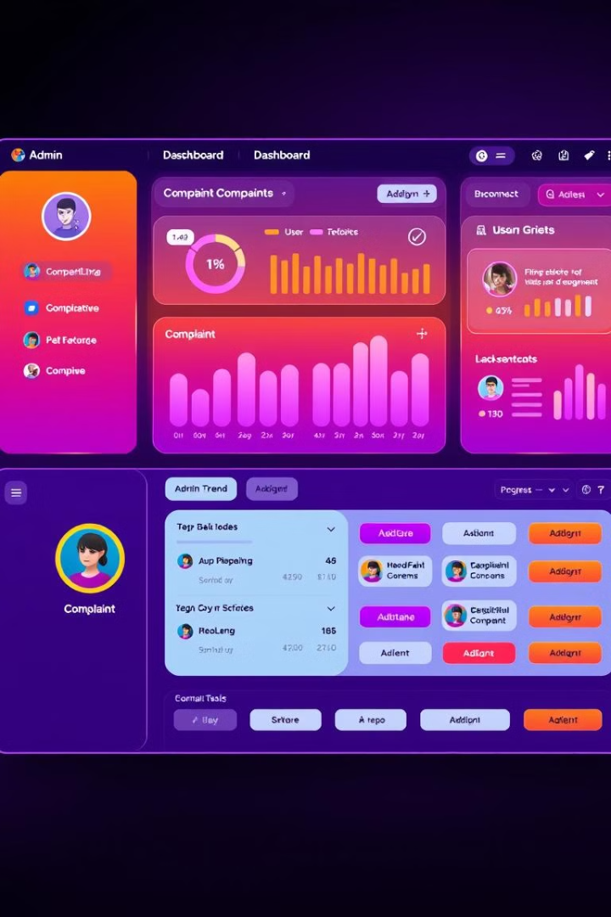
Admin Features
Comprehensive tools for admins to manage the complaint system.
User Management
Create and maintain user accounts.
Complaint Allocation
Assign complaints to appropriate agents.
System Oversight
Monitor and maintain the overall system.

Slide 6




Agent Features
Enabling agents to efficiently resolve customer complaints.
View Complaints
Agents can see their assigned complaints.
Investigate Issues
Agents research and find solutions.
Update Status
Agents communicate progress and resolutions.

Slide 7
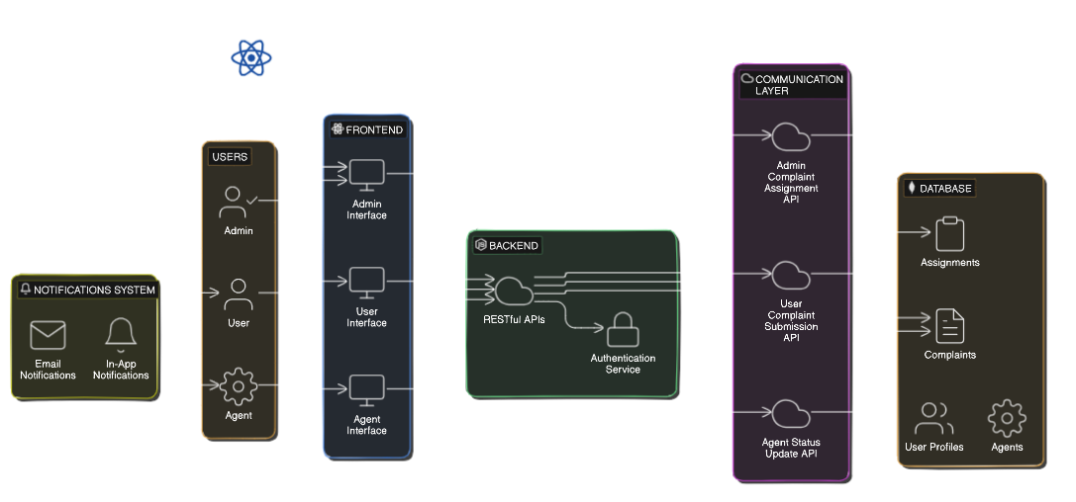
System Architecture

Slide 8






Technologies Utilized
Leveraging the latest technologies to deliver a robust and scalable solution.
React.js
Node.js
Modern web framework for the frontend.
Powerful runtime for the backend.
MongoDB
AWS
Flexible NoSQL database for storage.
Cloud platform for hosting and scaling.

Slide 9

Benefits of the System
Improving efficiency and providing better resolutions for customer complaints.
1
Faster Resolutions
Streamlined workflow reduces complaint response times.
2
Enhanced Visibility
Admins and agents have full oversight of complaints.
3
Improved Customer Satisfaction
Efficient handling of complaints leads to happier customers.

Slide 10
Thank You

